Slide 1
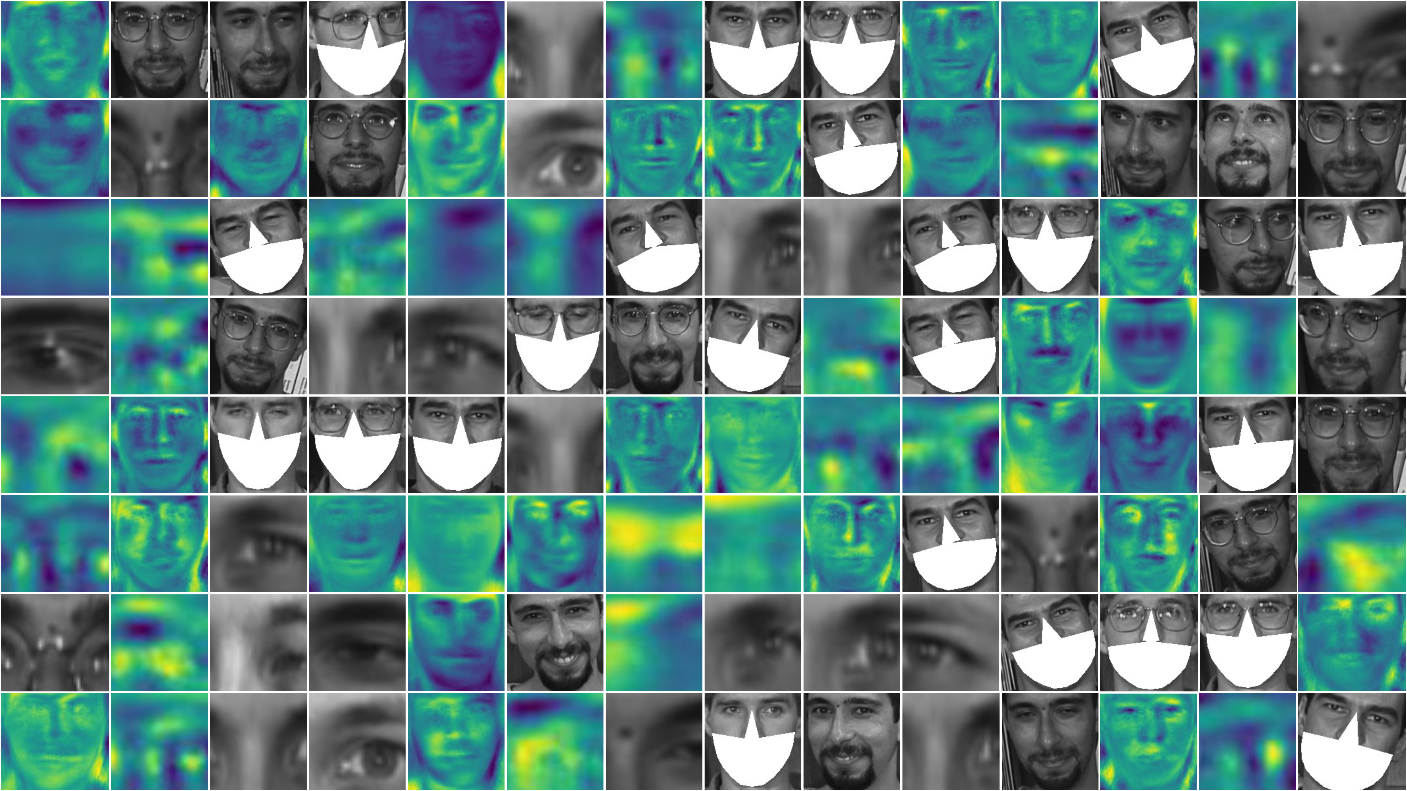
Masked Unmasked Face Recognition
Group 3

Slide 2
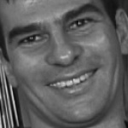
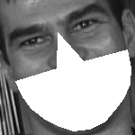
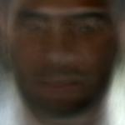
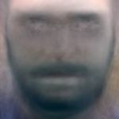
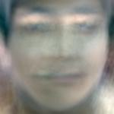
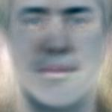
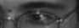
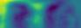
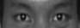

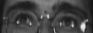
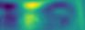
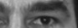
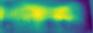
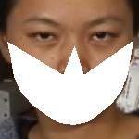
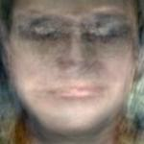
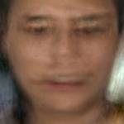
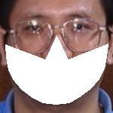
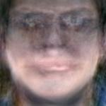
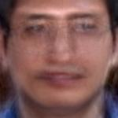
Our Pipeline
Testing Data Flow
Face Recognition
Training Data Flow
Create a masked face dataset
unmasked faces
Eigenface-based classification
Unmasked
testing data
SVM
Face mask detector
Unmasked training set
masked faces
Unmasked training set
Masked training set
Eyes detection
Robust face recognition with sparse representation
Masked testing data
Bonus level (Masked Unmasked Face Matching)
Unified Model
Eigenface with Importance
Weights(EIW) Decomposition

Slide 3
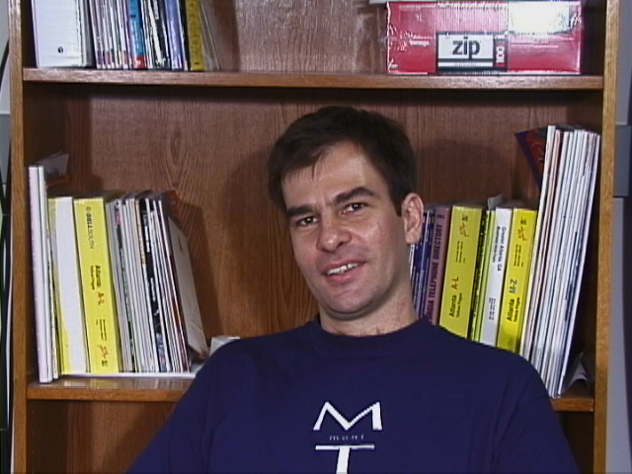
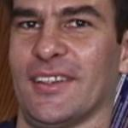
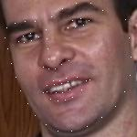
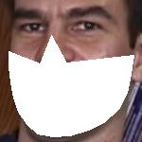
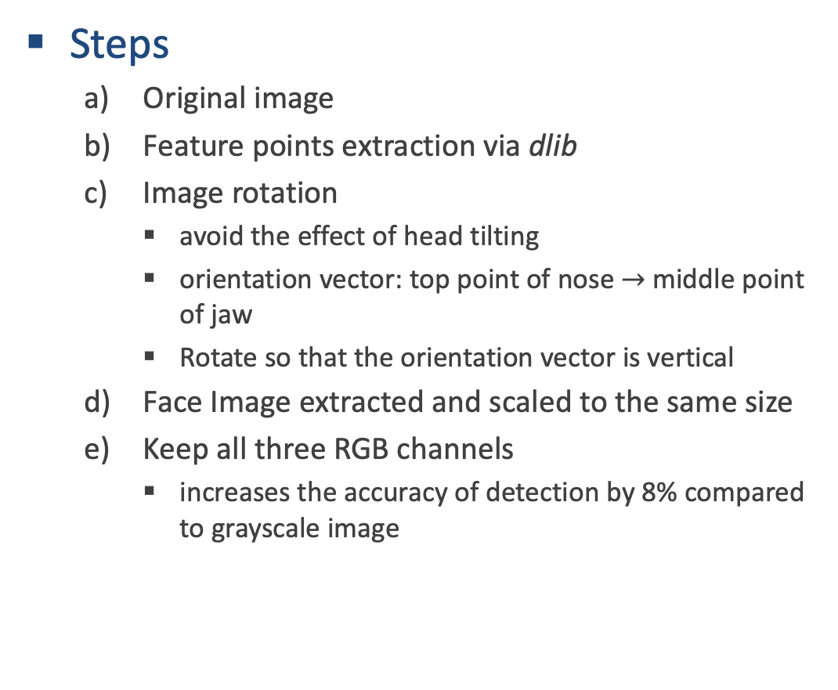
PREPROCESSING
Steps
Original image
Feature points extraction via dlib
Image rotation
avoid the effect of head tilting
orientation vector: top point of nose $→$middle point of jaw
Rotate so that the orientation vector is vertical
Face Image extracted and scaled to the same size
Keep all three RGB channels
increases the accuracy of detection by 8% compared to grayscale image

Slide 4
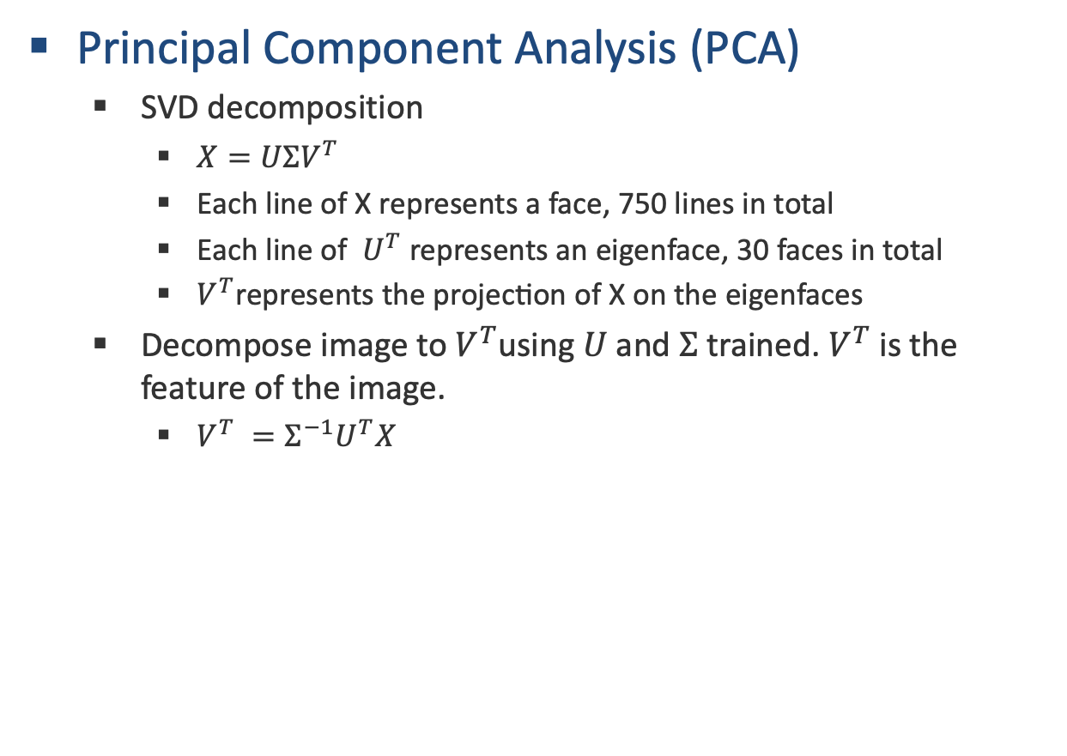
FEATURE EXTRACTION
Principal Component Analysis (PCA)
SVD decomposition
$X=UΣV^{T}$
$\text{Each} \text{line} \text{of} \text{X} \text{represents} \text{a} \text{face}\text{, 750 }\text{lines} \text{in} \text{total}$
$\text{Each} \text{line} \text{of} U^{T}$ $\text{represents} \text{an} \text{eigenface}$, 30 faces in total
$V^{T}\text{represents} \text{the} \text{projection} \text{of} \text{X} \text{on} \text{the} \text{eigenfaces}$
Decompose image to $V^{T}$using $U$ and $Σ$ trained. $V^{T}$ is the feature of the image.
$V^{T} =Σ^{−1}U^{T}X$
Figure: Eigenfaces

Slide 5

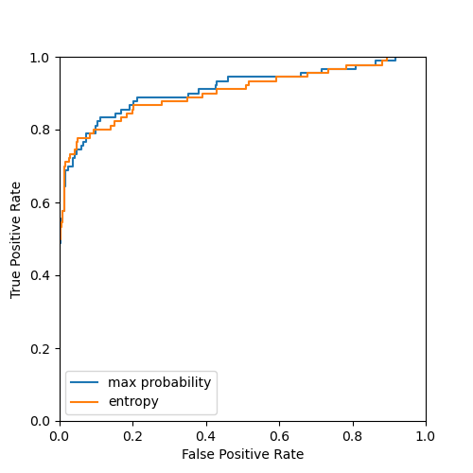
CLASSIFIER
SVM classifier
X: the feature of the face image
Y: the belonging of the face
Calculate its confidence level on 50-class-classification (information entropy or maximum probability) to determine whether the face belongs to a positive test subject.
Expert level solved?
T2: Unmasked Face Recognition: ROC AUC 0.91 ✅
T3: Masked Face Recognition (temporally): ROC AUC only 0.74?
Figure: Confusion Matrix of T2
Figure: ROC of T2

Slide 6
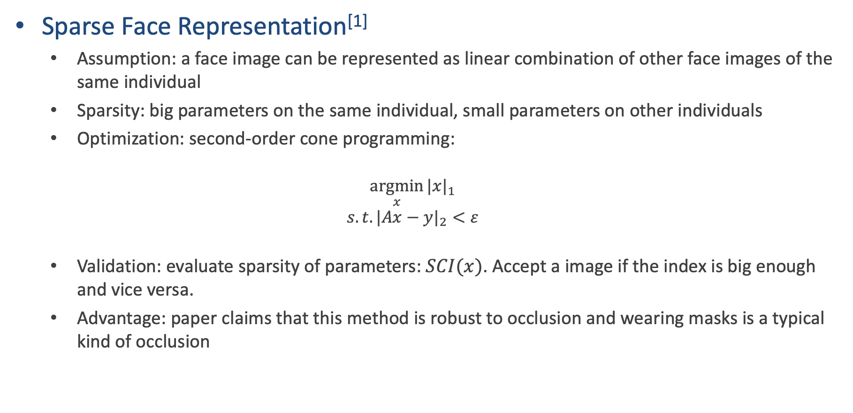
WAY TO THE FINAL MODEL
Sparse Face Representation^{[1]}
Assumption: a face image can be represented as linear combination of other face images of the same individual
Sparsity: big parameters on the same individual, small parameters on other individuals
Optimization: second-order cone programming:
$$\underset{x}{argmin}{{|x|}_{1}}$$
$$s.t. {|Ax−y|}_{2}<ε$$
Validation: evaluate sparsity of parameters: $SCI(x)$. Accept a image if the index is big enough and vice versa.
Advantage: paper claims that this method is robust to occlusion and wearing masks is a typical kind of occlusion

Slide 7
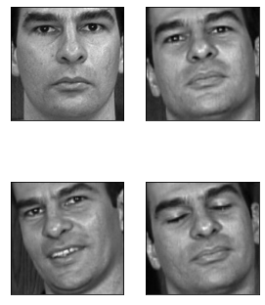
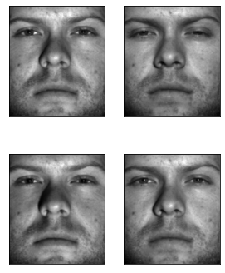
WAY TO THE FINAL MODEL
Sparse Face Representation
Feature extraction method: random faces proposed by the paper, but performance is not good
Performance: max accuracy 0.60
Strange! Still fail to reach the performance claimed in the paper(90%+) and is not robust to occlusion
Linear assumption is not suitable for pose & expression change
Our dataset
Original dataset

Slide 8
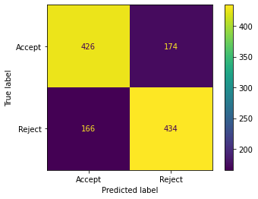
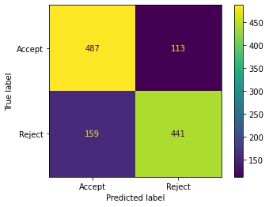
WAY TO THE FINAL MODEL
Still use Eigenface+SVM
Use PCA as feature extraction and SVM as classifier
Use binary classification as classifier? Positive test images labelled as 1s and negative as 0s?
No. This could easily make a mistake when unseen negative input comes
Validation based on probability distribution
Train a multiclass SVM on positive subjects
Retrieve probability distribution by softmax of scores
Validate by highest probability mass
Performance
AUC ROC only 0.74, Maximum accuracy 0.77
Validation: masked
Validation: no-mask

Slide 9
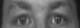
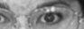
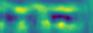
WAY TO THE FINAL MODEL
Eyes detection
Reasons
mask covers most of the information of the face,
the position of the mask will affect the accuracy of PCA
Crop the eyes of the faces without mask
PCA decomposition
SVM Classifier
Average accuracy: 0.58
Analysis: Some images are wrongly extracted with only one eye, resulting in the extra information of the eyes’ position in the eigenvector

Slide 10
WAY TO THE FINAL MODEL
Use unmasked eigenfaces to exploit masked faces’ feature!
Not work :(
Analysis
The features will try to imitate the mask with whiter faces,
and thus, yields bad results
Improvement
Introduce weights on eigenfaces
Decompose faces on non-orthogonal basis
Figure: Masked image is tried to be recomposed by unmasked eigenfaces

Slide 11
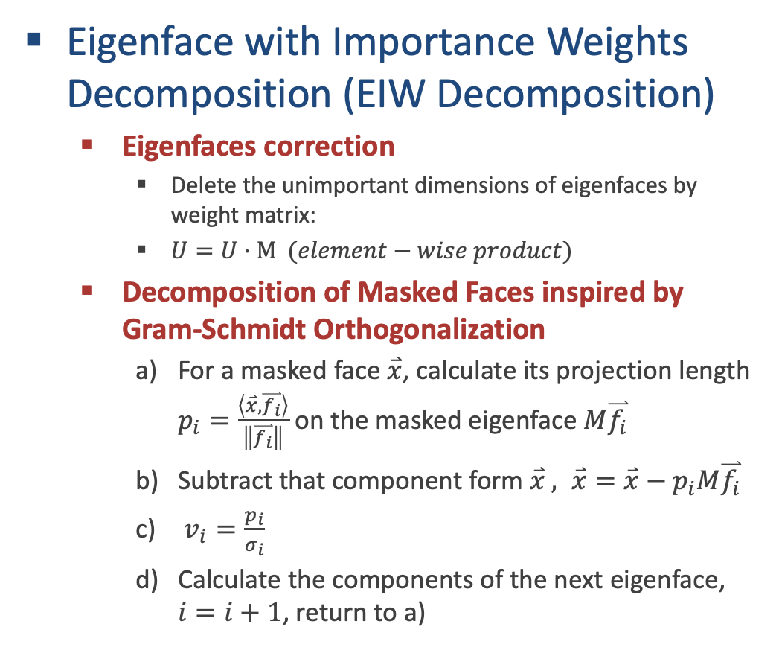
IMPROVEMENTS
Eigenface with Importance Weights Decomposition (EIW Decomposition)
Eigenfaces correction
Delete the unimportant dimensions of eigenfaces by weight matrix:
$U=U·M (element−wise product)$
Decomposition of Masked Faces inspired by Gram-Schmidt Orthogonalization
For a masked face$\overset{⃑}{x}$, calculate its projection length $p_{i}=\frac{\left\langle \overset{⃑}{x},\overset{⃑}{f_{i}}\right\rangle }{\left\|\overset{⃑}{f_{i}}\right\|}$ on the masked eigenface $M\overset{⃑}{f_{i}}$
Subtract that component form $\overset{⃑}{x} , \overset{⃑}{x}=\overset{⃑}{x}−p_{i}M\overset{⃑}{f_{i}}$
$v_{i}=\frac{p_{i}}{σ_{i}}$
Calculate the components of the next eigenface, $i=i+1$, return to a)
Figure: From left to right: Original Masked Image; Recomposed image using naive SVD Decomposition; Recomposed image using EIW Decomposition

Slide 12
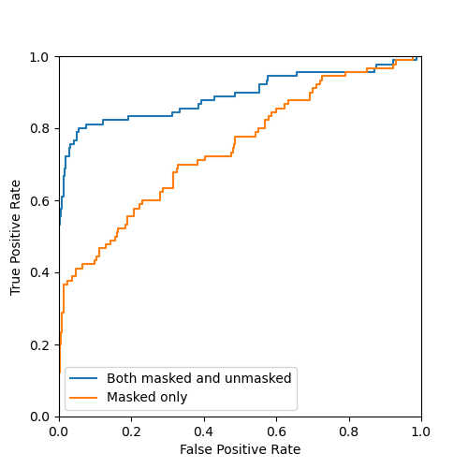
FINAL MODEL
The recomposed face is similar enough!
We can directly use unmasked data to train SVM, since EIW decomposed features of masked and unmasked faces are similar.
Expert level T3 and bonus level finish at once!
Performance
Expert level T3: ROC AUC of Unmasked Face Matching
Trained on only unmasked faces using naïve PCA method: 0.74 (orange line)
Trained on both masked and unmasked faces
using EIW decomposition: 0.89 (blue line) Huge Improvement!
Bonus level: 50-classification Accuracy:
Trained on only unmasked faces: 0.76
Figure: ROC of T3

Slide 13

FINAL MODEL
The unified model can work on all tasks!
Do PCA and fit SVM on unmasked faces
For an income image, use the mask detector build before to detect whether a mask exists:
If so, do EIW decomposition and feed to the SVM
If not, do SVD decomposition and feed to the SVM
Performance on Expert Level T4 (unified pipeline)
Accuracy: 85%
Confusion Matrix on the right
Figure: Confusion Matrix of T4

Slide 14
REFERENCE
All the performance data are achieved with randomization with seed “42”.
[1]: J. Wright, A. Y. Yang, A. Ganesh, S. S. Sastry and Y. Ma, "Robust Face Recognition via Sparse Representation," in IEEE Transactions on Pattern Analysis and Machine Intelligence, vol. 31, no. 2, pp. 210-227, Feb. 2009, doi: 10.1109/TPAMI.2008.79.

Slide 15
Thank you

